Slide 1
Neuraxial anesthesia in obstetric patients with intracranial and spinal pathology when is it safe?
Lawrence Weinstein, MD
University of California, san diego
August 12, 2023

Slide 2
Introduction
Parturients with intracranial or spinal pathology present unique challenges that may make neuraxial anesthesia more dangerous
Patients with intracranial lesions are often assumed to have elevated ICP
Risk of herniation often cited as contraindication to neuraxial
To assess safety of neuraxial we must understand factors that contribute to clinically significant brain tissue shifts
ICP
Brain edema
Hydrocephalus
Must weigh risks vs. benefits specific to individual patients
Spinal cord abnormalities may make neuraxial more challenging or risky
Scoliosis
Prior back surgery
Spinal cord injury
Spina bifida

Slide 3
Learning goals
Appreciate the way intracranial lesions can affect icp, csf flow, and herniation risk
Learn about intracranial compliance and mechanisms to alleviate pressure
Learn effects of pregnancy & labor on CSF and ICP
Develop an approach to assessing the safety of spinal or epidural anesthesia in the setting of intracranial pathology
Understand general anesthesia goals in the setting of elevated icp
Gain insight into potential issues with neuraxial anesthesia in the setting of spinal cord or vertebral abnormalities
Develop an approach to management of labor analgesia and cesarean delivery anesthesia for parturients with spinal cord pathology

Slide 4
Intracranial Anatomy & Physiology
Cranium is rigid and contains:
Blood (150 cc)
CBF varies with pH, CO₂
In setting of tumor or eclampsia, BBB may be compromised leading to edema and elevated ICP
CSF (150 cc cranial, 150 cc spinal)
In ventricles, flows freely into spinal SA space normally
Produced by choroid plexus 20 cc/hour
Obstruction to flow can produce non-communicating hydrocephalus
Brain Tissue (1400 cc)
Relatively non-compressible

Slide 5
Intracranial Compliance
Within the noncompliant bony skull, the sum total of the intracranial volume remains a constant, such that an increase in the volume of any one component causes a compensatory decrease in the volume of another.
“Zero sum game” called Monro-Kellie Doctrine
Intracranial Compliance C = ΔV / ΔP
CSF and blood can be displaced if brain tissue volume increased slowly, keeping pressure relatively low
At a certain point though, there is no further ability to shift CSF or blood flow and ICP will rise steeply with further increases in brain mass

Slide 6
Intracranial Compliance Curve
Notes:
Once the ability of CSF and blood to be diverted from intracranial to extracranial spaces is exhausted, any further increase in volume rises ICP quickly

Slide 7
Effects of Pregnancy and Labor on CSF
Gravid uterus and obesity can compress Subarachnoid space and decrease lumbar CSF volume
Exaggerated spinal medication spread
CSF pressure increases with contractions 2.5 mm Hg
Epidural med injection compresses dural sac, displacing CSF upward, transiently increasing ICP
This might be significant if already at high ICP, since near steep part of compliance curve
Intermittent small volumes have less ICP effect than large volume
Normally, total intracranial volume is low enough so that ICP fluctuations with labor remain in normal range

Slide 8
Features of Increased ICP
Clinical
headache
Pupil changes or asymmetry
Eye movement abnormalities
Papilledema
Hemiparesis
Facial weakness
New seizures
Altered consciousness
Radiologic CT / MRI
Tense dura
Flattened gyri
Narrowed sulci
Effaced cisterns
Compressed or dilated ventricles
Shift of midline structures
Displacement of brain tissue caudad

Slide 9
Space Occupying Brain Lesions
Pregnancy does not change risk of developing a brain tumor
Meningiomas and pituitary adenomas may be hormone responsive and enlarge with pregnancy
When assessing safety of neuraxial anesthesia, critical to know its effect on intracranial compliance and ICP
Location and size
Rapidity of growth
Presence of tissue or fluid shifts
Patency/obstruction of CSF flow pathways
Pressure gradient between intracranial and spinal compartments?

Slide 10
Space Occupying Brain Lesions
To safely perform neuraxial, there should be preservation of free CSF flow between brain and spinal space, and no pressure differential between the spaces
In setting of pressure gradient, loss of CSF via Dural puncture could force brain tissue to shift downward
Normally, during a dural puncture, CSF from the intracranial cavity shifts downward to equilibrate the pressures so that there is no effect on brain tissue
In setting of elevated ICP with mass effect or any obstruction to CSF flow, brain tissue is at risk for shifting instead, resulting in potential for herniation with neurologic injury

Slide 11
Space Occupying Brain Lesions
Brain tumors do not always result in increased ICP
If small and remote from CSF pathways, there may be little to no ventricle compression or tissue shifts
In such a case, small loss of CSF with spinal or transient increase in ICP with epidural loading should be well tolerated
Case reports of parturients with asymptomatic brain tumors having successful neuraxial anesthesia for c-section or assisted vaginal deliveries
Notes:
Left occipital pole tumor surrounded by edema that has no visible mass effect on ventricles and no midline shift

Slide 12
Space Occupying Brain Lesions
If brain mass obstructs free flow of CSF, or causes tissue shift, then risk of herniation with dural puncture is increased
More likely if mass is near anatomically narrowed part of ventricular system, like 3rd ventricle or cerebral aqueduct, or at foramen magnum
Tumors near foramen magnum or posterior fossa may bottleneck CSF flow
Low lying cerebellar tonsils, as in Arnold-Chiari malformation
Very slow growing tumors may cause little to no symptoms of elevated ICP
However, if compensatory fluid shifts have been exhausted, dural puncture could still precipitate brain tissue shift and herniation

Slide 13
Space Occupying Brain Lesion with Mass Effect
Notes:
A – Normal ventricles
B – large Right supratentorial mass with left midline shift and compression of right lateral ventricle
C, D – coronal and axial images of large right frontal tumor with obstruction of foramen of Monroe and dilation of lateral and temporal horns. There is midline shift and subfalcian heriniation

Slide 14
Arnold Chiari Malformation
Cerebellar tonsils descended at least 5 mm through foramen magnum
Type I – most common, sometimes asymptomatic, or Headache, ataxia, sensory/motor impairment of extremities
Type II – present in infancy, often with myelomeningocele
Both cerebellar tonsils and brain stem tissue in foramen magnum
Episodic apnea, cranial nerve dysfunction, upper extremity weakness
Type III – further protrusion of cerebellum and brain stem
Severe neurologic dysfunction
Type IV – cerebellar hypoplasia
Surgical correction with cranio-cervical decompression and duraplasty removes obstruction and restores CSF flow
However, careful exam and history should be done to rule out persistent deficits and imaging should demonstrate patent CSF flow

Slide 15
Arnold Chiari Malformation
There are many case reports of successful epidural and spinal anesthetics performed in Arnold-Chiari patients
Known Arnold Chiari type I with minimal symptoms
Surgically corrected patients
Only anesthesia related consequence dural puncture headaches
There are also case reports of persistent post dural puncture headaches refractory to treatment that, upon imaging, demonstrate and acquired Arnold-Chiari malformation with sub-foramen migration of tonsils
Large dural punctures with persistent CSF leak can cause cerebellar descent, even without existing Arnold-Chiari

Slide 16
Increased ICP does not always mean increased herniation risk!
Idiopathic intracranial HTN (pseudotumor cerebri) is common condition with increased ICP
Increased ICP (> 20 cm H₂O) with normal CSF composition and absence of underlying cause
Extraventricular CSF volume and ICP high
Symptoms headache, stiff neck, papilledema, visual loss
No obstruction to CSF flow → loss of CSF with dural puncture accommodated by caudal flow of CSF
Does not increase herniation risk with dural puncture

Slide 17
Intracranial Vascular Pathology
Arterio-Venous malformations or aneurysmal disease can result in SA hemorrhage during pregnancy
Usually clinically devastating
Neurosurgical management same as if not pregnant
Following a bleed, there may be increased ICP or CSF flow obstruction
If patient is stable and there is no need for urgent neuro intervention, then anesthesia for delivery should consider risks for elevated ICP or CSF flow obstruction
In setting of known cerebro-vascular disease, blood pressure goals should be established and adhered to carefully so as not to precipitate a re-bleed

Slide 18
Stable Intracranial Vascular Pathology
Historically, asymptomatic non-ruptured aneurysm patients have been counseled to avoid pushing:
Valsalva → increased CBF and ICP → compensatory increased in BP →increased transmural pressure at aneurysm → rupture
Another fear was that a persistent CSF leak following neuraxial could cause decreased ICP with compensatory rise in CBF
This has not been actually reported
Recent review found pregnancy and labor did NOT increase risk of aneurysmal SA hemorrhage
No need to advise against pregnancy or vaginal delivery
No contraindication to neuraxial labor analgesia/anesthesia in absence of signs of elevated ICP or CSF flow obstruction
Epidural or spinal anesthesia very effective at avoiding bp spikes from labor or endotracheal intubation, and are preferred when safe

Slide 19
Individual Patient Assessment
Each patient with intracranial pathology is unique
Anesthesia consultation and interdisciplinary planning important
Anesthesia options may depend on delivery plan (vaginal vs. section)
Safety of a neuraxial anesthetic should be established as early as possible, and communicated to anesthesia and OB colleagues, and the patient
Ideally, recent imaging demonstrating presence of absence of mass effect and preserved CSF flow
Is patient asymptomatic from an elevated ICP perspective
Are there any other contraindications to neuraxial (back surgery, anti-coagulation, etc.)
To summarize: parturients with space-occupying lesions without mass effect, hydrocephalus, or clinical or imaging findings suggestive of elevated ICP are likely to have minimal to no increased risk of herniation from dural puncture!

Slide 20
General Anesthesia and Intracranial Pathology
Situations with signs of increased ICP or CSF obstruction may contraindicate neuraxial anesthesia
General anesthesia not without risk of neurologic issues
Minimize Valsalva during RSI and emergence → can increase ICP
HTN with intubation can be detrimental for vascular lesions
Blunt response with narcotic, deep anesthesia, or anti-HTN agents
Succinylcholine transient rise ICP → not likely clinically relevant
Limited role for hyperventilation as ICP reducing mechanism
CO₂ < 25 mm Hg decreased placental blood flow → fetal hypoperfusion/acidosis
Goal should be 25-30 until delivery
Airway issues
Aspiration issues if cranial nerve pathology
Anesthesia decision should be individualized to the specific case based on assessment of ICP and perceived risk of neuraxial anesthesia

Slide 22
Neuraxial anesthesia and scoliosis
Scoliosis incidence is about 2% overall, but twice as common in women
Increased risk for operative delivery
Scoliosis may make epidural and spinal anesthesia more challenging
Difficulty in placement (longer time, more attempts)
More common in patients with corrected scoliosis due to the presence of rods or scar tissue
Patchy or asymmetric block common in all scoliosis
Increased incidence of “wet tap” in surgically corrected patients
Surgical scarring can mask loss of resistance
Spinal medication spread much less effected than epidural spread, as intrathecal space is generally preserved with normal csf flow, though placement can be challenging

Slide 23
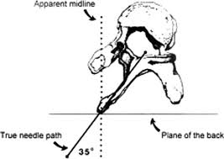
Neuraxial approach to scoliosis
Uncorrected scoliosis
Placement may be difficult, & patients are at risk for patchy block
Distorted anatomy makes identification of landmarks tricky
The epidural space midline is deviated toward the convex aspect of the curve relative to the spinous process.
Surgically corrected scoliosis
Presence of fusion rods makes placement challenging
Imaging studies helpful to learn location of fusion and presence or absence of a midline path to the dura
Rods can go down to L-4, so space to attempt placement is limited
When possible, attempt epidural below range of instrumentation
Spinal anesthesia spreads more reliably when space is accessible
may consider continuous spinal or intermittent single shot labor spinals if access is easy enough at L4-l5 or l5-s1
Spinal anesthesia reliable for cesarean delivery

Slide 24
Labor anesthesia with spinal cord injury (SCI)
Pregnant patients with spinal cord injury above t-6 are at risk for autonomic dysreflexia (AD)
Syndrome of massive, unbalanced reflex sympathetic discharge
Noxious stimuli below level of injury cause afferent impulses at sympathetic neurons in the spinal cord, resulting in sympathetic discharge → HTN and severe vasoconstriction below injury
Efferent inhibitory signals from cerebral vasomotor centers cannot go below level of SCI but will cause vasodilation, headache, flushing, and congestion in the face and upper extremities
Treat with rapid acting anti-hypertensives and removal of the noxious stimulus
Labor pain is a common trigger For ad
Early labor epidural is very effective at mitigating the response
For cesarean delivery, spinal or epidural anesthesia preferred to block pain signals that trigger
If general anesthesia is used, a deep plane of anesthesia needed to prevent ad
For at risk patients, consider an arterial line and have rapid-acting anti-HTN meds ready

Slide 25
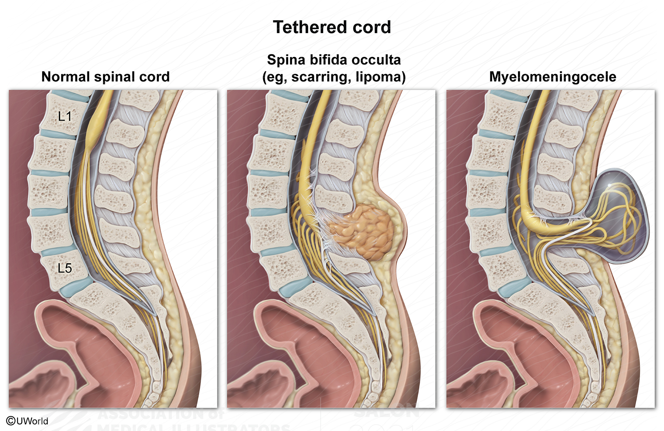
Spina bifida and tethered cord
Spectrum of congenital abnormality from failed neural tube closure
External skin abnormality or hairy patch present in up to 70%, but patients may have no external findings & may be asymptomatic
Even when surgically corrected, must MRI spine to rule out tethered cord and look at level of conus medullaris, which is lower in spina bifida
Neuraxial should only be attempted at levels not affected by anatomic anomaly

Slide 26
Recap and reminders
Intracranial and spinal cord pathologies pose a challenge to the obstetric anesthesia provider
The safety of neuraxial anesthesia should be assessed on a case-by-case basis
Patients should have an early anesthesia consultation so that a safe plan for analgesia and anesthesia can be established with the patient and the oB team
In situations where neuraxial is expected to be challenging, early placement and verification of a good epidural catheter should be considered
For patients with a contraindication to neuraxial technique, an analgesia and anesthesia plan should be made, and thorough assessment of the airway performed
Remember! Coordinated care and frequent communication is essential for the safety of all of our patients!

Slide 27
References
ACOG committee opinion number 275, September 2002: Obstetric management of patients with spinal cord injuries. (2002). Obstetrics &amp; Gynecology, 100(3), 625–627. https://doi.org/10.1016/s0029-7844(02)02261-5
Griffiths, S., & Durbridge, J. A. (2011). Anaesthetic implications of neurological disease in pregnancy. Continuing Education in Anaesthesia Critical Care &amp; Pain, 11(5), 157–161. https://doi.org/10.1093/bjaceaccp/mkr023
Ko, J. Y., & Leffert, L. R. (2011). Clinical implications of neuraxial anesthesia in the parturient with scoliosis. Obstetric Anesthesia Digest, 31(1), 53–54. https://doi.org/10.1097/01.aoa.0000393190.66961.ef
Lee, A. (2014). A parturient with scoliosis and Harrington rods. https://www.asahq.org/-/media/sites/asahq/files/public/education/2014-pblds/l128-158-lee.pdf?la=en&hash=CA5D01C1D261CB1223870FA48A917359382931B1
Leffert L, Schwamm L,; Neuraxial Anesthesia in Parturients with Intracranial Pathology: A Comprehensive Review and Reassessment of Risk. Anesthesiology 2013;119(3): 703-718.
Rossi, I., & Varaday, S. (2020, May 8). Neuraxial anesthesia for scoliosis and previous spinal surgery in pregnancy. WFSA Resource Library. https://resources.wfsahq.org/atotw/neuraxial-anesthesia-for-scoliosis-and-previous-spinal-surgery-in-pregnancy/
Su, Y., Lei, X., & Yu, J. (2022). Case report: Anesthetic management of cesarean section in a patient with paraplegia. Frontiers in Medicine, 9. https://doi.org/10.3389/fmed.2022.783796

